Slide 1
An Assessment of Risks and Threats
to the Space Landscape
Victoria Samson, Secure World Foundation
Presentation for “Space: Exploring NATO’s Final Frontier”
Organized by NATO Headquarters Supreme Allied Command Transformation,
the University of Bologna, and the Istituto Affari Internazionali
Forli, Italy
Nov. 9, 2023

Slide 2
Secure World Foundation (SWF) is a private operating foundation that promotes
cooperative solutions for space sustainability
Our vision: The secure, sustainable, and peaceful uses of outer space that contribute to global stability on Earth
Our mission: Secure World Foundation works with governments, industry, international organizations, and civil society to develop and promote ideas and actions to achieve the secure, sustainable, and peaceful uses of outer space benefiting Earth and all its peoples

Slide 3
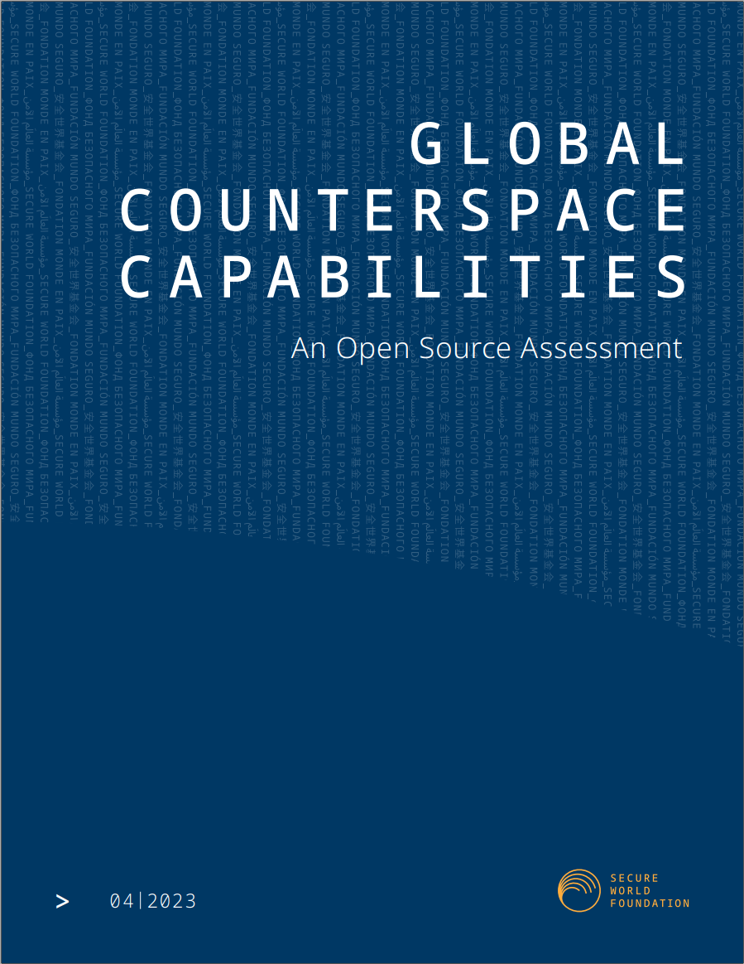
NATO Space November 2023
Existence of counterspace capabilities is not new, but the circumstances surrounding them are
Significant R&D/testing of a wide range of destructive & non-destructive counterspace capabilities by multiple countries
Only non-destructive capabilities are actively being used in current military operations
https://swfound.org/counterspace

Slide 4
NATO Space November 2023
Counterspace Capabilities
Direct Ascent: weapons that use ground, air-, or sea-launched missiles with interceptors that are used to kinetically destroy satellites through force of impact, but are not placed into orbit themselves;
Co-orbital: weapons that are placed into orbit and then maneuver to approach the target to attack it by various means, including destructive and non-destructive;
Directed Energy: weapons that use focused energy, such as laser, particle, or microwave beams to interfere or destroy space systems;
Electronic Warfare: weapons that use radiofrequency energy to interfere with or jam the communications to or from satellites;
Cyber: weapons that use software and network techniques to compromise, control, interfere, or destroy computer systems.
Space Situational Awareness: knowledge about the space environment and human space activities that enables both offensive and defense counterspace operations

Slide 5
NATO Space November 2023

Slide 6
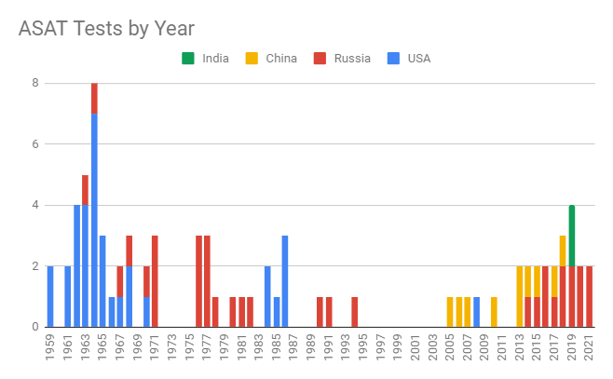
NATO Space November 2023
01

Slide 7
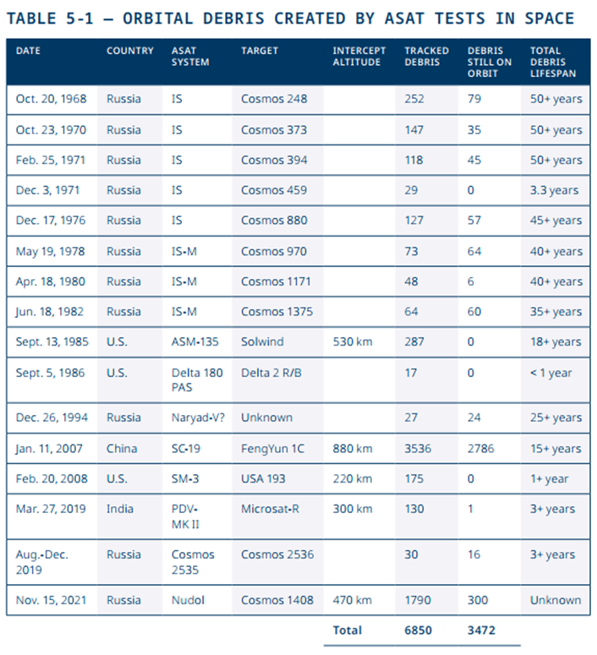
NATO Space November 2023
01

Slide 8
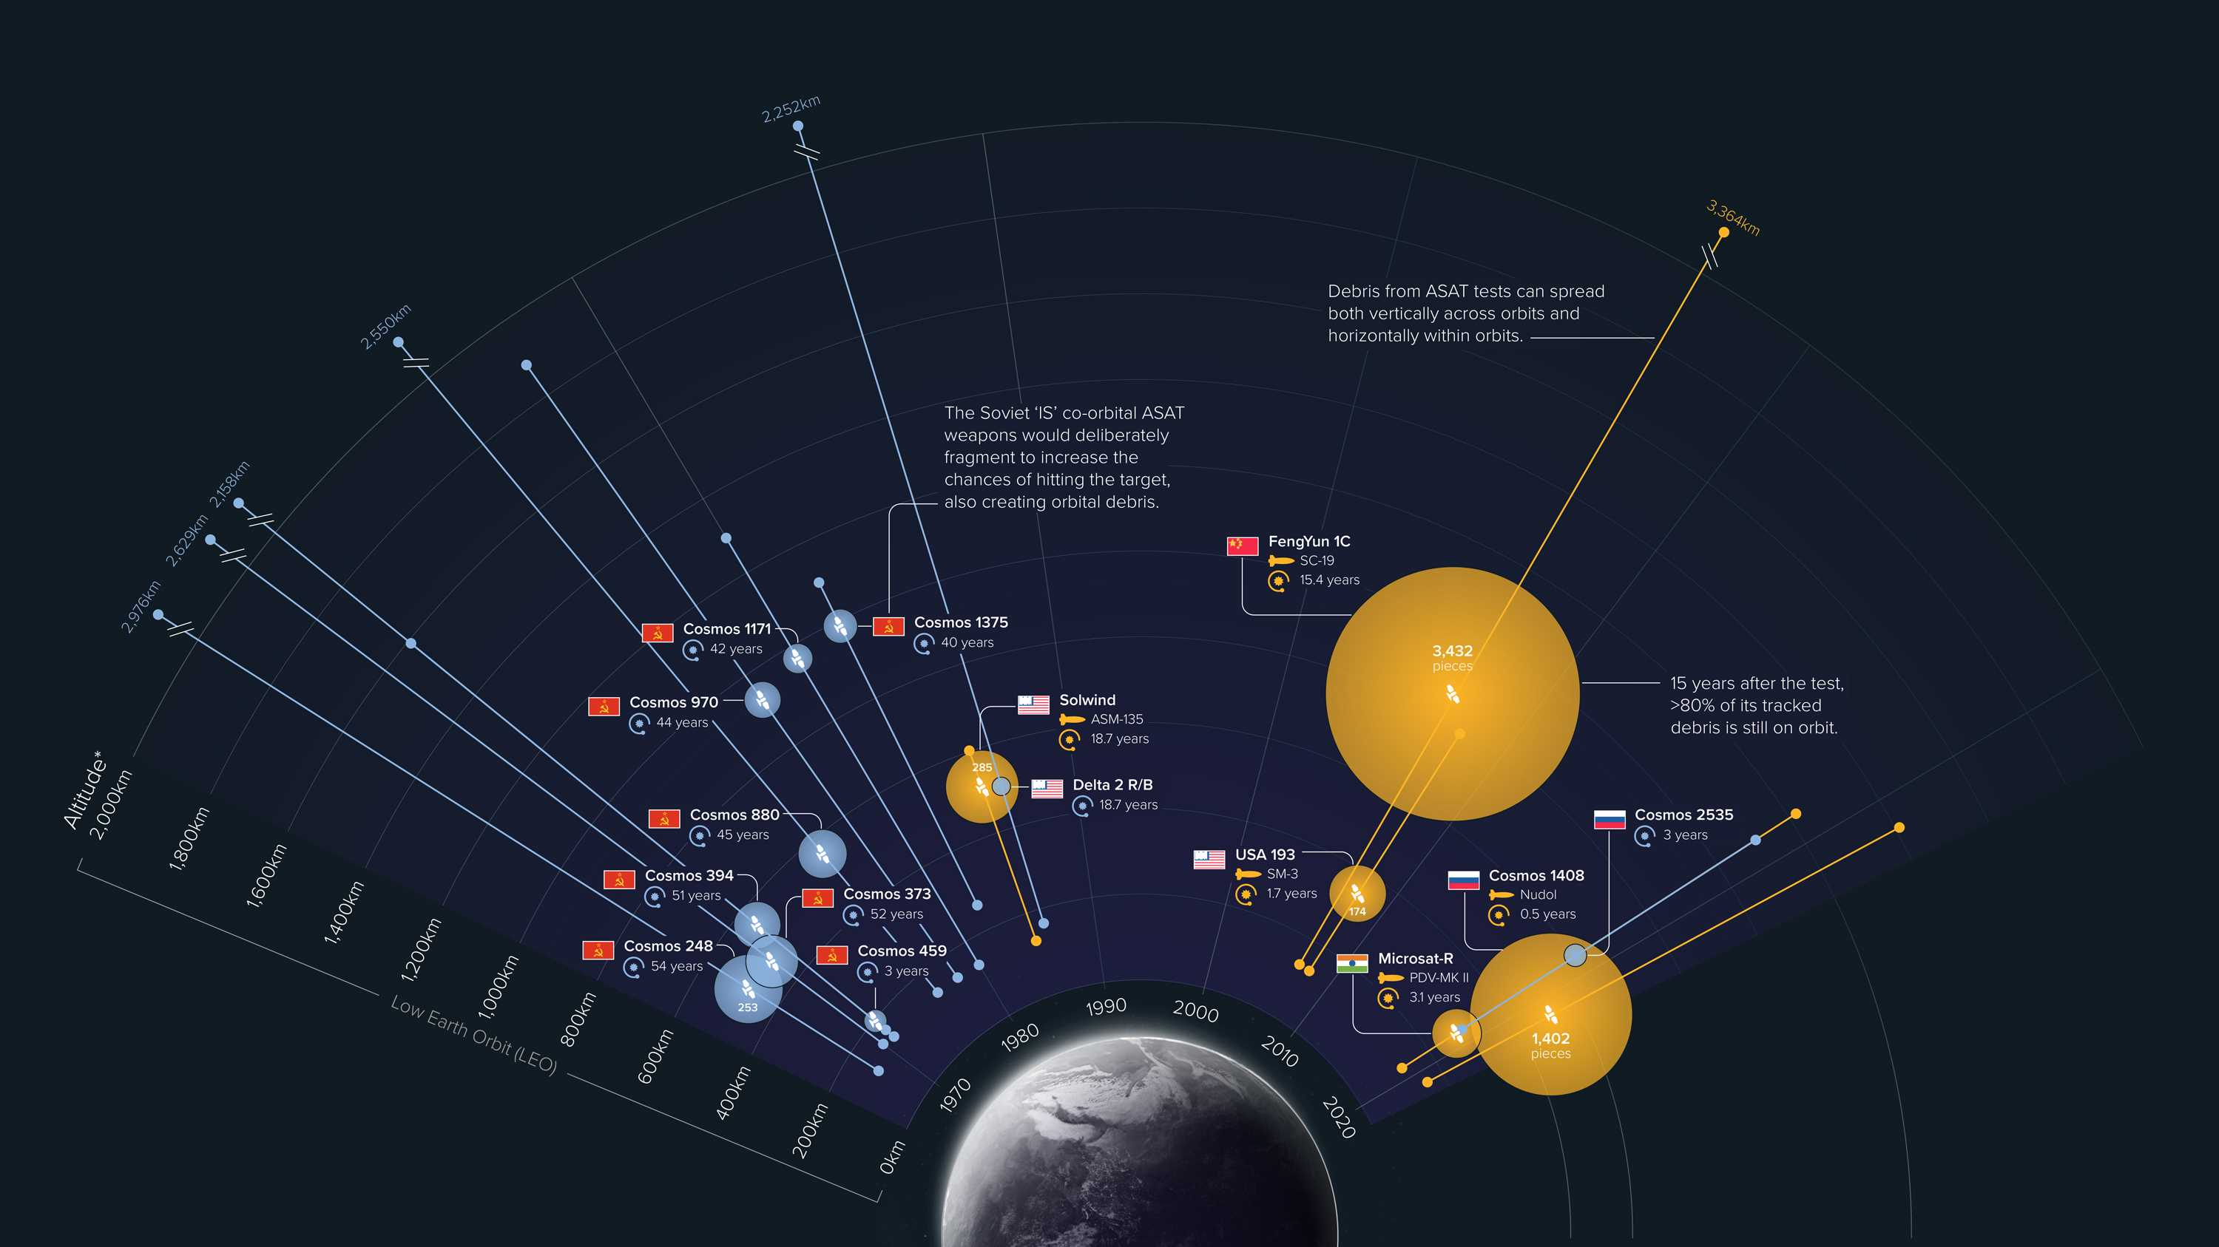
NATO Space November 2023
01

Slide 9
NATO Space November 2023
Case Study: ASAT Test Moratorium
Dangerous nature of space debris to satellites, humans in orbit
~9000 active satellites; ~48,000 pieces of debris we can track, ~900,000 pieces big enough to cause damage but too small to track
ASAT tests leave debris in orbit
At present, no way to deliberately get rid of debris (remediation)
International support growing for an ASAT test moratorium
Increasingly see the deliberate creation of debris/holding destructive ASAT tests as irresponsible behavior
In April 2022, the United States announced it was making a commitment not to conduct destructive direct-ascent anti-satellite missile tests
37 countries now have made this commitment
UNGA Res. 77/41 (Dec. 2022) called for same commitment; passed with a vote of 155-9-9
Underlines focus on behavior, not necessarily technologies
Aided by dwindling military utility of DA-ASAT tests
Notes:
“We would like to see all nations agree to refrain from anti-satellite weapons testing that creates debris,” Hicks

Slide 10
NATO Space November 2023
Case Study: No First Placement of Weapons in Outer Space
First proposed by Russia in 2004 and in subsequent annual UNGA resolutions
31 countries have made this non-legally binding political commitment
China is not one of them, although it has voted for the related UNGA resolutions
SWF has a tracking sheet that tracks the votes on and sponsors of UNGA resolutions for this from 2014 on: https://swfound.org/multilateral-space-security-initiatives/
December 2022 UNGA Res. 77/42: 123 – 50 – 3
“Encourages all States, especially spacefaring nations, to consider the possibility of upholding, as appropriate, a political commitment not to be the first to place weapons in outer space”
Concern: how do you define a weapon? What about technology that is dual-purpose?
Also, the implication is that it is fine to be second to put weapons in space
Notes:
“We would like to see all nations agree to refrain from anti-satellite weapons testing that creates debris,” Hicks

Slide 11
NATO Space November 2023
Close Approaches and Effects on Space Stability
Uncoordinated close approaches: potential for (inadvertent) escalation
Not as easy to make hard and fast requirements about
Different risk assessments by different actors in space
Very few hard “rules” about what is and isn’t allowed
Intent is key – how do you demonstrate intent?
Need for rules of the road: right of way, ways to quickly communicate amongst actors, IncSea for space?
Role of space situational awareness and its limitations

Slide 12
NATO Space November 2023
Congestion On and Around the Moon
106 cislunar and lunar missions by 19 countries and one multilateral organization (ESA)
Activities on the Moon are changing
Artemis Accords vs International Lunar Research Station?
Complications on Earth replicating on the Moon?

Slide 13
NATO Space November 2023
Responsible behavior in space
Just wrapped up two-year process of UN Open-ended Working Group on Reducing Space Threats
Success? Yes and no
Interest converging on many issue areas, including avoiding deliberate creation of debris, need for rules on actions (notifications, consultations) prior to conducting rendezvous and proximity operations, value of TCBMs
Jessica West (Ploughshares)’s analysis of types of recommendations for responsible behavior: operating with due regard, sharing information, avoid contamination of space environment, avoid harmful interference, non-use of force

Slide 14
NATO Space November 2023
Tools for Improving Communication, Transparency
Lexicon for Outer Space Security (https://unidir.org/publication/lexicon-outer-space-security)
Intended to facilitate shared understandings of key topics and terms
Three types of terms:
Acronyms
Common definitions
Terminology frequently used in space security discussions that could benefit from further clarification
Space Security Portal (https://spacesecurityportal.org/)
Interactive map of global space governance landscape
Seeks to support informed participation by interested stakeholders and support transparency, information-sharing, and capacity-building

Slide 15
Questions?
Thanks.
Victoria Samson, vsamson@swfound.org
@SWFoundation

